Slide 1
Prompt Engineering
Session11
Arunkarthik T

Slide 2



Prompt Engineering - an Art, a Science, or your next Job Title?
From Microsoft

Slide 3
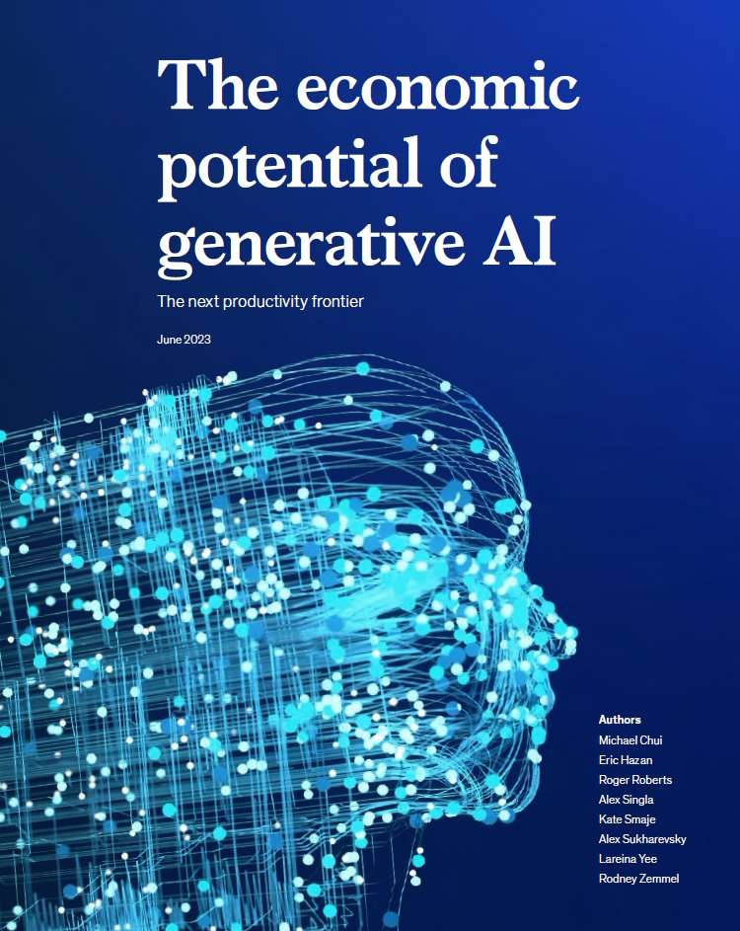
Generative AI’s impact on productivity could add up to
$4.4 trillion annually in value to the global economy.
About 75% of the value that generative AI use cases
could deliver falls across customer
operations, marketing, sales, software engineering, and R&D .
Generative AI can revolutionize work by automating a significant portion of employees' activities, up to 60- 70% of their current workload. This augmentation of individual capabilities has the potential to transform the way we work.

Slide 4








Artificial Intelligence
The field of computer science that seeks to create intelligent machines that can replicate or exceed human intelligence
Artificial Intelligence
1956
Machine Learning
Machine Learning
Subset of AI that enables machines to learn from existing data and improve upon that data to make decisions or predictions
1997
Deep Learning
Deep Learning
A machine learning technique in which layers of neural networks are used to process data and make decisions
2017
Generative AI
Generative AI powered by foundation mode s
Create new written, visual, and auditory content given prompts or existing data
2021

Slide 5
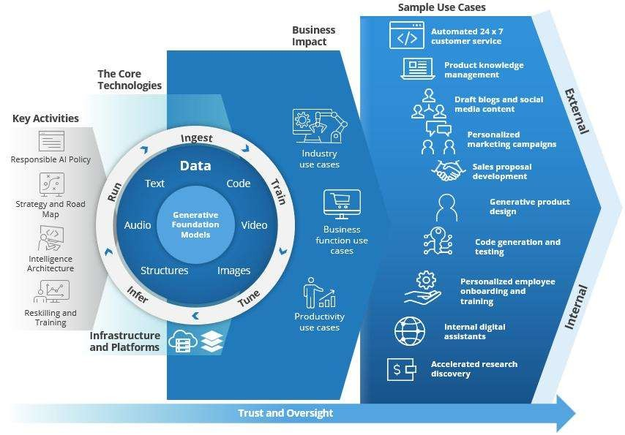

Path to impact and usecases
Source: IDC, IDC PlanScape: Developing Your Path to Impact with Generative AI, #US51157323

Slide 6
Emerging model landscape
•
OpenAI's
GPT2, ChatGPT, GPT-3, GPT3.5, GPT4.0 (language) DALL-E 2 (image),
and Whisper (speech)
Stability.ai's Stable Diffusion (image)
Midjourney (image)
•
Google's
PaLM, PaLM2, LaMDA, Minerva, UL2, Bard (language), and Imagen
(image)
Google/DeepMind's Chinchilla, Retro-7B, AlphaCode (language), Flamingo, and Gato (multimodal)
•
Meta's
LLaMa, NLLB, OPT-175B, Sparse all-MLP (language), Make-a-Video
(video), and data2vec (multimodal)
Microsoft's
•
BigScience's BLOOM (language)
AI21 Labs' Jurassic-X (language)
Dolly 2.0 (language)
•
DeepNet (language) and MetaLM (multimodal)
…

Slide 7

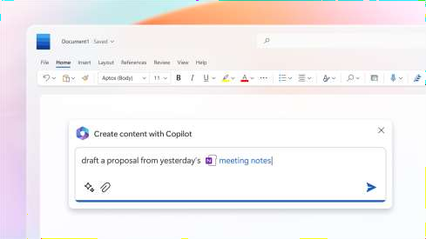
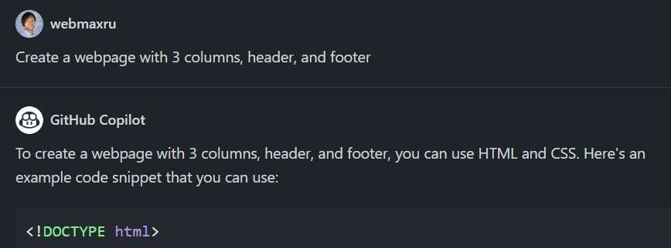
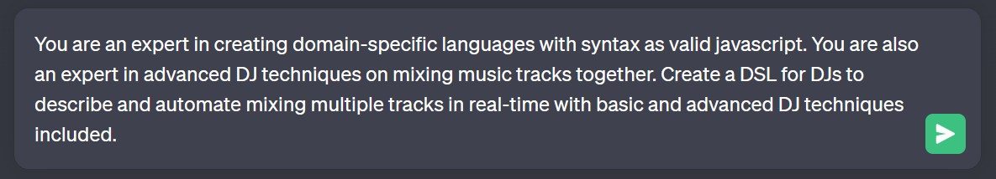
One common thing…

Slide 8




Prompt Engineering
Process of designing, refining, and optimizing input prompts to guide a model toward producing more accurate outputs while keeping cost efficiency

Slide 9

Prompt anatomy
Write a product launch email for new headphones.
<
This product is AI-powered and priced at $79.99.
The tone is friendly and exciting.
Output as a JSON object with "subject" and "body" fields. Example:
{
"subject": "Introducing Our New AI-Powered Headphones!",
"body": "We are thrilled to announce the launch of our new AI- powered headphones"
}
Output:
<
Instruction
Input data Context Target format
Example
Cue

Slide 10

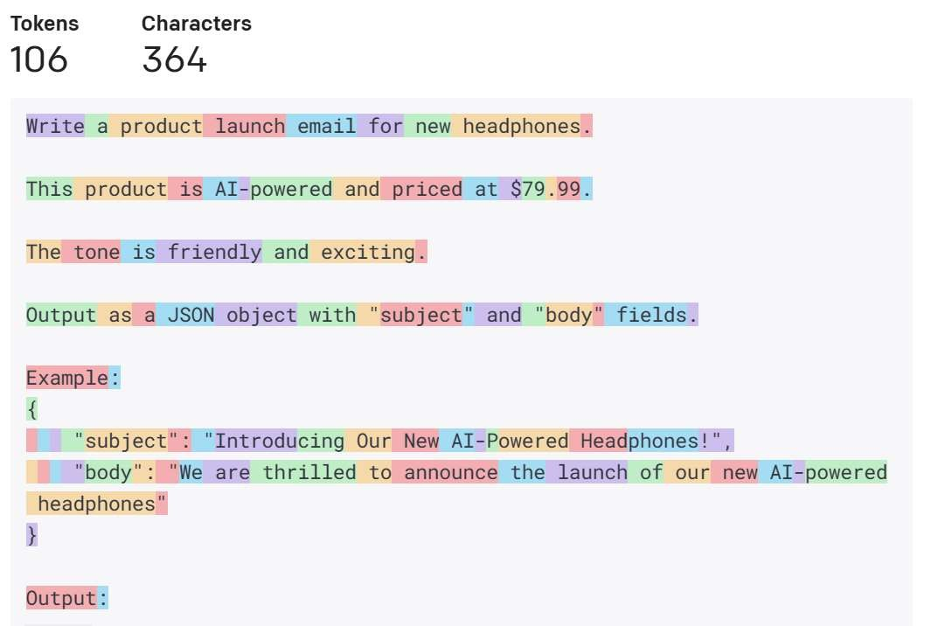
Tokens

Slide 11
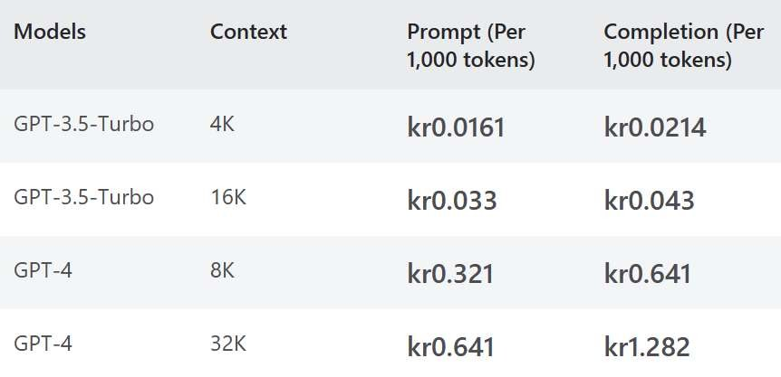
Prompts and cost efficiency
Prompt and completion length
Number of API calls in production
Number of API calls during development (experimentation stage)
Type of deployed model
Model selection strategy: Start with heaviest models and gradually ramp down to cheaper ones
while the result is satisfactory

Slide 12


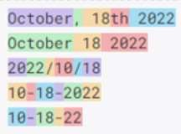
Space efficiency
•
Tokens can sometimes be counter-intuitive
Tabular data is space-efficient

Slide 13
General recommendations
Be specific
Order matters
Double down
Give the model an “out”

Slide 14
Technical recommendations
Start with clear instructions and repeat the instructions at the end
Add clear syntax: headers, separators
Break the task down
Adjust parameters: Temperature and Top probabilities

Slide 15



Zero shot VS few shot prompts
Zero-shot
The model predicts the answer given only a natural language description of the task.
Few-shot
In addition to the task description, the model sees a few examples of the task.
Classify customer's question. Classify between category 1 to 3.
Detailed guidelines for how to choose:
choose 1 if the question is about auto insurance. choose 2 if the question is about home flood insurance.
choose 3 if the question is not relevant to insurance.
Classify customer's question. Classify between category 1 to 3. Detailed guidelines for how to choose: choose 1 if the question is about auto insurance. choose 2 if the question is about home flood insurance. choose 3 if the question is not relevant to insurance.
Customer question: Hi there, do you know how to choose flood insurance? Classified topic: 2 Customer question: Hi there, I have a question on my auto insurance. Classified topic: 1
Customer question: {insert new question here} Classified topic:
Customer question: What packages do you have in auto insurance? Classified topic:

Slide 16






Zero Shot
Reasoning
After
What is the annual water demand of a single family household con ing people who are at home an average of 200 days per year and use an average of 10 liters of er per day?
Before
What is the annual
er demand o a single family
household containing
people who are at home an
average of 200 days per year and use an ave of 100 liters of er per day?
The annual water demand of a single-family household containing four people who are at home an average of 200 days per year and use an average of 100 liters of water per day is 8,000,000 liters per year.
Let’s think step by step and explain the calculation
step by step.
Step 1: Calculate total number of ays n a ear: There are 365 days in a yea
Step 2: Calculate the total number of days e fami is at
The fa ly is at home an average of 200 days per ear.
e:
Step 3: Calculate the total water demand of the family:
The fa ly uses an average of 100 liters of water per day. Therefore, the tot water demand of the family is 100 liters x 200 days 20,000 ters p year.
Step Calculate the annual water demand of the single fa ly household:
The annual water demand of the ngle family household is 20,000 ters per year.

Slide 17








Few Shot Reasoning Example
1st prompt
2nd prompt—provide reasoning
Roger has 5 te alls. Each can does he have
is balls. He buys 2 mo e cans o tennis Roger has 5 te is balls. He buys 2 more cans o tennis
as 3 tennis balls. How many tennis balls balls. Each ca as 3 tennis balls. How many tennis balls
does he have now?
Answer: Roger started with 5 balls. 2 cans of 3 tennis balls
each is 6 tennis balls 5+6 = 1. The answer is
Answer: The answer is
The cafeteria has 23 apples. If they used 2 to make lunc and bought 6 more how many do they have?
The cafeteria has 23 If they use
20 to make lunch
and bought 6 more how many do they have?
The answer is 27
The cafeteria had 23 apples originally. They used 20 to make lunch. So they had 23-20 = 3. They bought 6 more apples, so they have 3 + 6 = 9. The answer is 9.

Slide 18

















Prompt Chaining
Entity Extraction
Summarization
Sentiment Analysis
lease extract entities from the following news article: The new Phone model is set to be released next month. It has been highly anticipated by Apple fans and is expected to fe e ger sc ee and improved camera
lease summarize the informatio about the product
[{'text': hone', 'type': 'PRODUC },
{'text': Apple 'type':
ORGANIZATION
Please provide a sentiment for the following text:
The iPhone is a line of smartphones designed and marketed by Apple nc. These devices combine computer, camera, and internet connectivity in a single
and are own for their eek
design and use friendly interface.
The iPhone is a line of smartphones designed and marketed by Apple Inc. These devices combine a computer, camera, and internet connectivity in a single device, and are known for their sleek design and user-friendly interface.
{'text': 'iPhone', 'type’:
'PRODUCT'}, {'text': 'Apple’,
'type': 'ORGANIZATION'}]
Positive

Slide 19






ew Shot Reasoning Example 2
1st prompt—Reason Extraction
On average Joe throws 25 punches per min e.
fight lasts 5 rounds of 3 minutes. How many
punches did he row?
Let’s think step by step and explain the calculation
step by step.
2nd prompt—Answer Extraction
One average Joe throws 25 punches per minute. A fight lasts 5 rounds of 3 minutes. How many punches did he row?
In one minute, Joe throws 25 punches.
In three minutes, Joe throws 3 * 25 = 75 punches. In five rounds, Joe throws 5*75 = 375 punches.
In one minute, Joe throws 25 punches.
In three minutes, Joe throws 3 * 25 = 75 punches. In five rounds, Joe throws 5*75 = 375 punches.
The cafeteria has 23 apples. If they used 20 to make lunch
and bought 6 more how many do have?
Therefore the answer numerals) is
The cafeteria had 23 apples originally. They used 20
to make lunch So they had 23 20 = 3. They bought 6
more apples, so they have 3 + 6 = 9. The answer is 9.

Slide 20



Then all summaries are passed to GPT again to summarize, i.e. second round of summarization. The sum of the summaries has to fit within the token limit.
Prompt Chunking (token limit)
Please summarize and extract topic: Global warming refers to the gradual increase in the overall temperature of the Earth's atmosphere, primarily caused by the burning of fossil fuels such as coal, oil, and natural gas. This burning releases carbon dioxide and other greenhouse gases into the atmosphere, which trap heat and cause the Earth's temperature to rise.
Please summarize the following text: 'Climate change is a pressing issue that needs to be addressed immediately. The increasing levels of carbon dioxide in the atmosphere are causing the Earth's temperature to rise, which is leading to more frequent and severe natural disasters. Governments around the world need to take immediate action to reduce carbon emissions and invest in renewable energy sources. Failure to do so will have dire consequences for future generations'"
Large Text Beyond Token Limit
Climate change is a pressing issue that needs to be addressed immediately. Governments around the world need to take immediate action to reduce carbon emissions and invest in renewable energy sources. Failure to do so will have dire consequences for future generations
Chunks
The text is discussing global warming, which is the gradual increase in the overall temperature of the Earth's atmosphere caused by the burning of fossil fuels. This burning releases greenhouse gases, such as carbon dioxide, into the atmosphere which trap heat and cause the temperature to rise. The text also highlights the urgency of the issue of climate change and the need for governments to take action to reduce carbon emissions and invest in renewable energy sources. Failure to address this issue will have negative consequences for future generations.
Climate change is a pressing issue that needs to be addressed immediately. Governments around the world need to take immediate action to reduce carbon emissions and invest in renewable energy sources. Failure to do so will have dire consequences for future generations
Topic: Climate change and Global warming.
Continue to next prompt

Slide 21
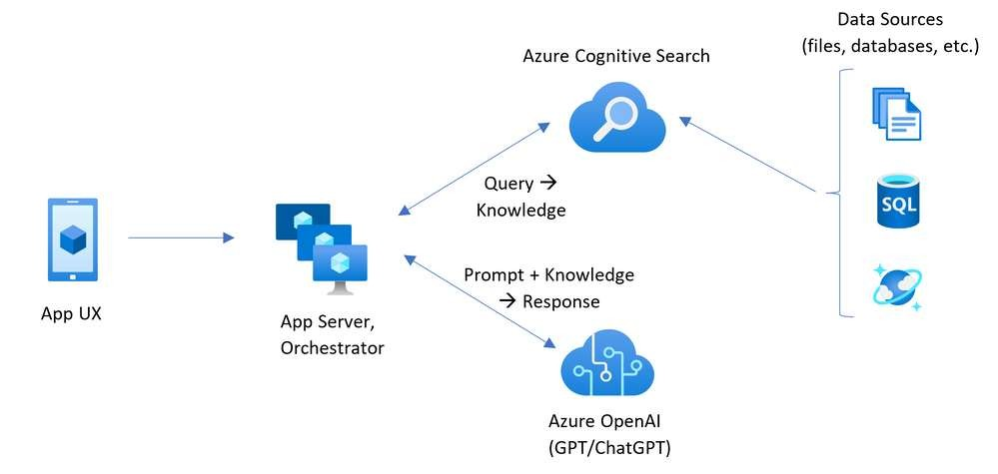
Retrieval Augmented Generation (RAG)
Extract precise answers from your unstructured documents with Azure OpenAI + Cognitive Search: article + repo
https://learn.microsoft.com/en-us/azure/search/retrieval-augmented-generation-overview

Slide 22
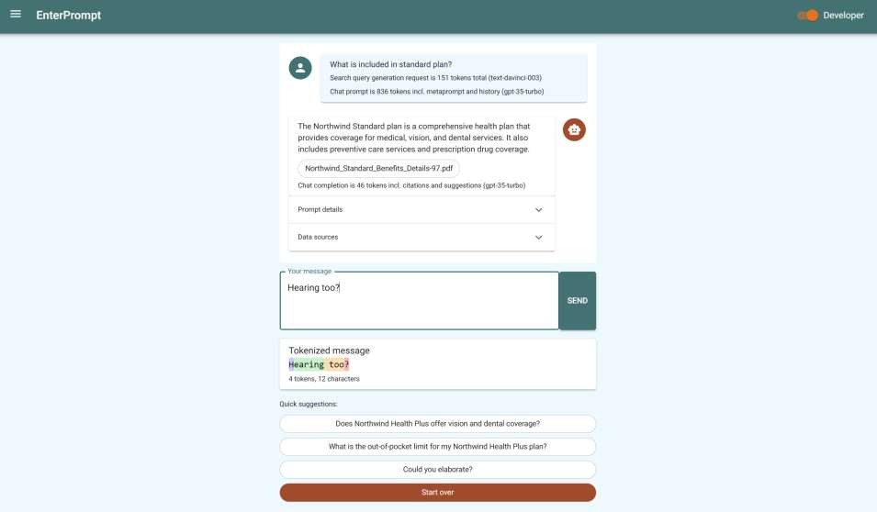

https://enterprise.promptengineering.rocks

Slide 23
















Recently Announced
Azure OpenAI Service on your data
Data Sources
(search, files, databases, storage etc.)
API & SDK
App or
Copilot agent
Azure OpenAI
Service on your data
Additional 3P Data Sources
(files, databases, storage data etc.)
https://learn.microsoft.com/en-us/azure/ai-services/openai/concepts/use-your-data

Slide 24



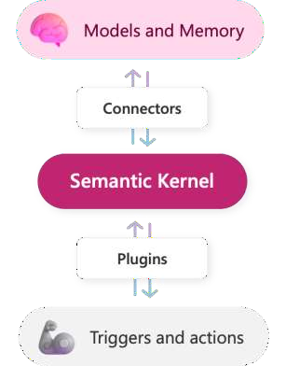














LangChain
Semantic Kerne
https://github.com/langchain-ai/langchain
https://github.com/microsoft/semantic-kernel

Slide 25




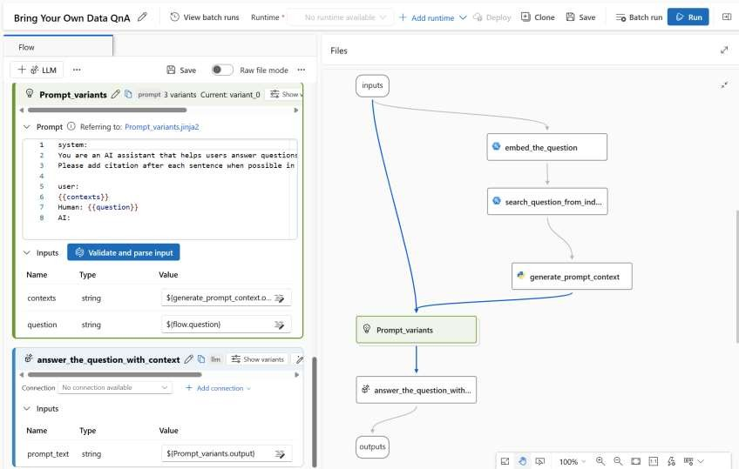
Prompt low
streamline dev cycle of LLM based apps
https://github.com/microsoft/promptflow

Slide 26

Learning resources
Learn Prompting Community
Prompting Guide by DAIR.AI
Prompt Engineering for the developers on Deep Learning
Prompt Examples
https://cookbook.openai.com/n OpenAI
https://platform.openai.com/docs/examples
Introduction to Prompt Engineering on Microsoft Learn

